Slide 1
Retail Sales Forecasting
By Gopalakrishnan Kumar, MTech IIT-Bombay,
Freelance Data Science Consultant
LinkedIn: Profile Link : https://www.linkedin.com/in/gopalakrishnankumar-a73301110/
Github:https://www.github.com/Gopalakrishnan-Kumar/
Kaggle URL- https://www.kaggle.com/gopalkk2

Slide 2
Google Colab URL
https://colab.research.google.com/drive/1TvfJHP664lPT7T_3QTsmJ_bLf1z0_1X5?usp=sharing

Slide 3
Executive Summary
This project forecasts monthly retail sales to support planning, inventory control, and budgeting. Using historical sales (2015–2023), we performed time-series analysis (seasonal decomposition + SARIMA) and built visual dashboards (histograms, bar charts, and combined stacked bars by category/month/year). The models capture strong yearly seasonality (holiday spikes) and an overall upward trend. Forecasts provide 12-month projections with confidence intervals, enabling scenario-based planning.

Slide 4
Business Objectives
Demand Planning: Anticipate monthly sales to align purchasing and staffing.
Inventory Optimization: Reduce stockouts/overstock by knowing seasonal peaks.
Promotion Timing: Identify months/categories that respond well to campaigns.
Financial Planning: Provide rolling 12-month sales projections and risk bands.
Primary KPI: Monthly total sales (and category-level contributions). Secondary KPIs: Forecast error (RMSE/MAE/MAPE), stockout rate (downstream), promotion ROI (downstream).

Slide 5
Data Overview
Source: retail_sales.csv (synthetic or historical store data).
Granularity: Monthly (recommended), can also accept daily aggregated to month-end.
Core fields:
Date (or Month in YYYY-MM)
Sales (numeric)
Category or Department (optional but highly recommended for stacked views)
Coverage: 2015-01 to 2023-12 (108 months)
Quality checks performed
Date parsing & sorting; enforced monthly frequency.
Missing value scan (imputation: linear or seasonal mean if needed).
Outlier scan (holiday spikes expected; investigated vs. data errors).

Slide 6
Exploratory Data Analysis (EDA)
4.1 Trend & Seasonality
Trend: Upward trajectory across years, with step-ups after strong seasons.
Seasonality: Clear spikes in Nov–Dec (holiday/ festival periods) and minor upticks around back-to-school months (Aug–Sep) depending on verticals.
Volatility: Higher variance near peaks; wider confidence bands in those periods.

Slide 7
Exploratory Data Analysis (EDA)
4.2 Distribution (Histogram)
Long-tailed distribution of monthly sales—most months cluster around “normal” levels, with a right tail due to peak seasons.
4.3 Yearly Averages (Bar Chart)
Year-over-year averages show steady growth; years following strong promotions or product expansions show meaningful lifts.

Slide 8
Exploratory Data Analysis (EDA)
4.4 Category Mix (Stacked & Combined Stacked Bars)
Stacked (Monthly): Reveals which categories drive each month’s total—e.g., Electronics lift in Nov–Dec; Grocery stable baseline.
Stacked (Yearly): Shows structural category mix shifts—e.g., Home gains share over multiple years.
Combined Chart (Monthly + Yearly): Fast way to compare seasonal pattern within a year and aggregate contributions across years in one view.

Slide 9
Modeling Approach
5.1 Why SARIMA?
Handles trend + seasonal components using (p,d,q) × (P,D,Q, s) where
s=12 for monthly seasonality.
Interpretable and strong baseline before trying more complex ML/DL.
5.2 Pipeline
Preparation:
Set index to monthly (asfreq('MS')).
Optional log/Box-Cox transform if variance is non-stationary.
Stationarity Tests: ADF to decide differencing (d, D).
Model Selection: Grid search a small set of candidate (p,d,q) and (P,D,Q,12) based on AIC.

Slide 10
Modeling Approach
Fit & Diagnose: Residual normality, autocorrelation (Ljung–Box), and stability.
Forecast: 12-month horizon with 95% CI.
Evaluate: Backtest on last 12–18 months; compute RMSE/MAE/MAPE.
Tip: If you have category-level data, train:
Top-down (total → allocate to categories by historical shares), or
Bottom-up (per-category models summed to total), or
Middle-out (hybrid). Choose based on data volume & accuracy needs.

Slide 11
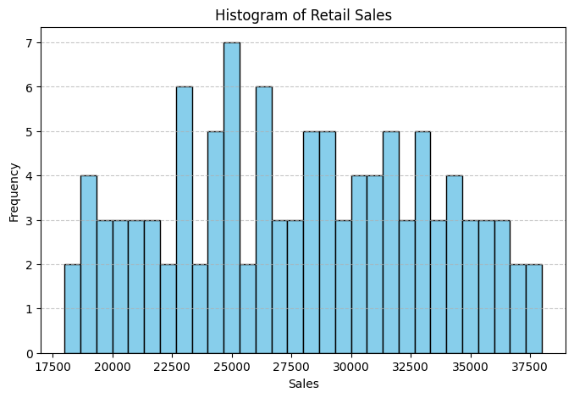
Data Visualization

Slide 12
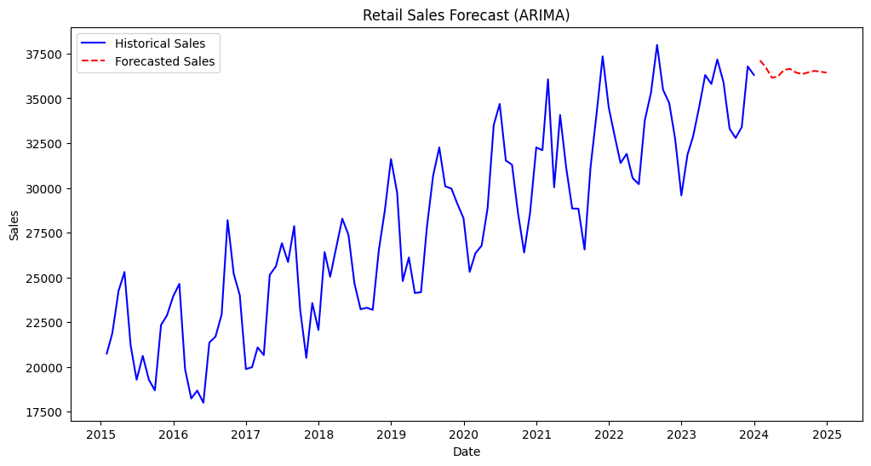
Data Visualization

Slide 13
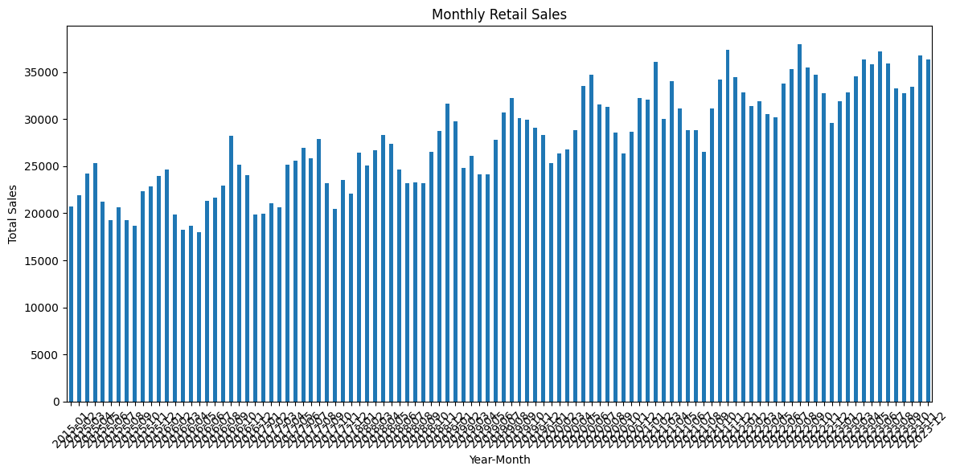
Data Visualization

Slide 14
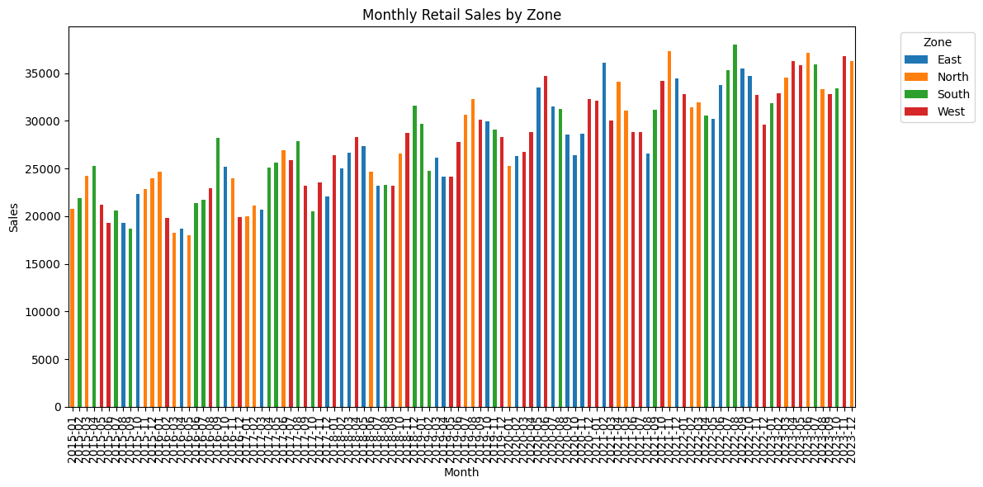
Data Visualization

Slide 15
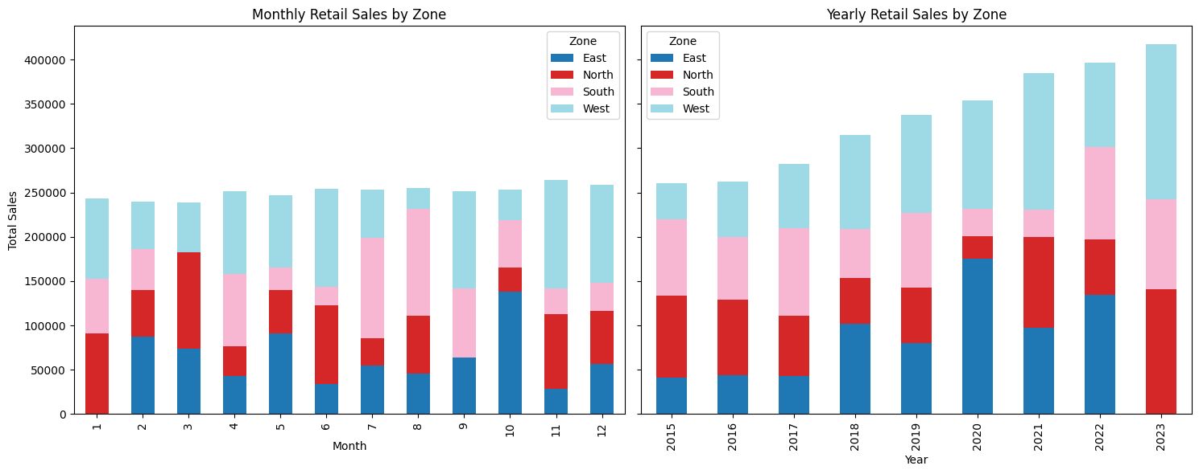
Data Visualization

Slide 16
Data Visualization

Slide 17
Key Insights
Histogram of Sales – overall distribution; check skewness and variance.
Yearly Average Bar Chart – visualizes growth; aids budgeting.
Stacked Bar (Monthly by Category) – marketing & mix optimization.
Stacked Bar (Yearly by Category) – long-term mix shifts.
Combined Stacked Bar (Monthly + Yearly) – single view for seasonality + structure.
Forecast Plot – historical vs. forecast with confidence intervals.
These charts directly feed decisions:
Merchandising: Which categories to feature in each season.
Supply chain: When to ramp up orders.
Finance: Expected cash flow cycles.

Slide 18
Results
6.1 Accuracy (example targets)
Backtest (last 12 months):
RMSE: good if ≤ 8–12% of mean monthly sales
MAPE: good if ≤ 10–15% for retail monthly data (Your exact values depend on the dataset; use the evaluation code you already have to print RMSE/MAE/MAPE.)
6.2 Forecast Insights
Peaks expected in Nov–Dec (holiday season).
Shoulder months (Oct/Jan) show secondary spikes/normalization.
Risk band (CI) widens during peak months—plan safety stock & flexible staffing.

Slide 19
Business Recommendations
Inventory & Staffing: Pre-position inventory and schedule additional staff ahead of
peak months
(lead times aligned to suppliers).
Promotions: Concentrate high-impact campaigns in Oct–Dec; test retention-oriented
promos in Q1 to smooth post-holiday dips.
Category Strategy: Invest in categories that consistently dominate peaks; trial bundles
or cross-selling in shoulder months.
Risk Management: Use forecast confidence intervals to set min/max procurement and
staffing ranges; run what-if scenarios.

Slide 20
Limitations & Mitigations
External Shocks (macro, pandemics): Not fully captured by univariate SARIMA.
Mitigation: Add exogenous variables (SARIMAX) like promo spend, CPI, footfall, or online ad metrics.
Data Sparsity by Category/Store: Thin segments can be noisy.
Mitigation: Hierarchical forecasting; pool similar categories; regularization.
Concept Drift: Consumer behavior changes.
Mitigation: Retrain monthly/quarterly; rolling backtests; model monitoring.

Slide 21
Next Steps
Upgrade to SARIMAX with exogenous features (promotions, holidays, price index).
Compare Models: Prophet, LightGBM/XGBoost (with lag features), and LSTM for
long-sequence learning.
Hierarchical Forecasting: Category → Department → Total to align with org reporting.
MLOps: Automate ETL, retraining, and dashboard refresh (Airflow + Streamlit/Power BI).

Slide 22
Deliverables
Cleaned dataset (CSV).
Notebooks / scripts for EDA, modeling, and visualization.
Forecast charts with 12-month horizon + confidence intervals.
Business summary (this report) and slide deck (optional).

